Slide 1
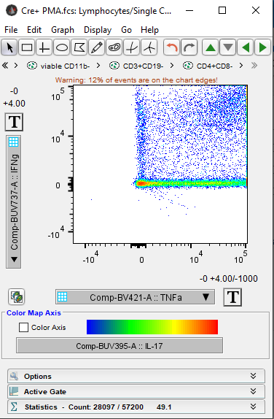
By default, FlowJo will display Aurora data like the example below. Since the Aurora records up to ~3x10^6, events will be offscreen. The biexponential transform will probably also be wrong.
First, adjust the max value displayed. Click on the “T” transform button and select “customize axis”.

Slide 2
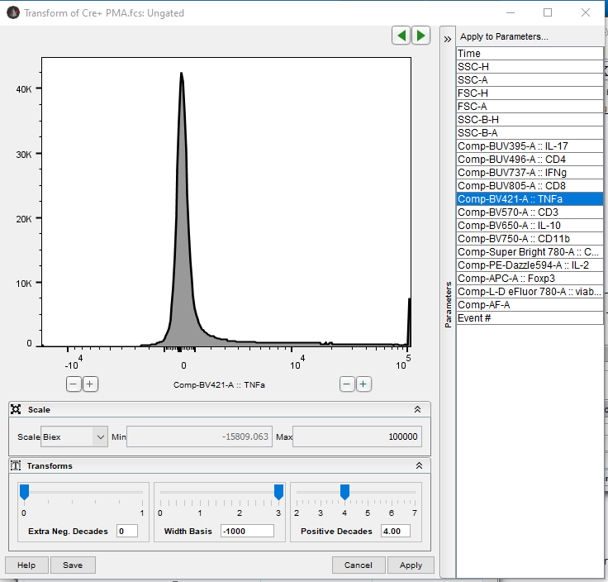
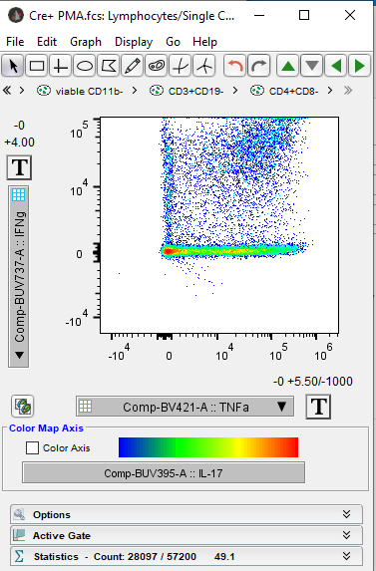
Click the “+” button three times. Hit “Save”. Hit “Apply” to close the window if you want to see how it looks.
Result:

Slide 3
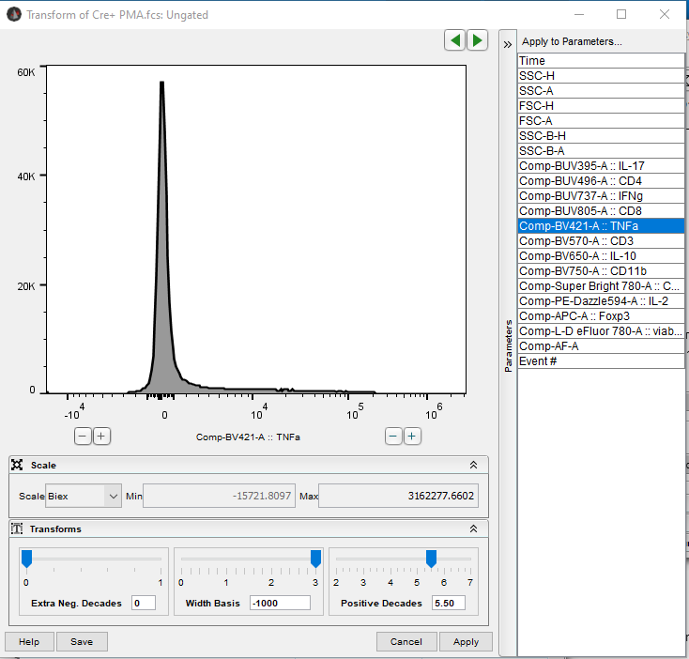
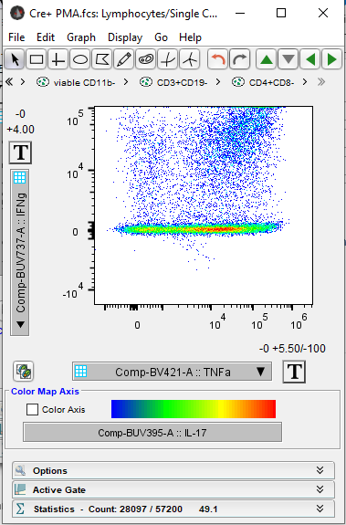
Now, adjust the biexponential transform. Toggle the “Width Basis” slider, or change the value. What value you select is mostly just aesthetics. It does not affect the values of the data, but may allow to see the distinction between positive and negative better.
Hit “Save”, hit “Apply”.
To set the transform on several channels at once, select them all under “Apply to parameters”.
Result:

Slide 4
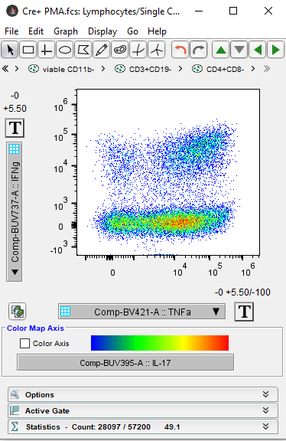
Repeat for the remaining fluorescent parameters. In theory, you should only have to do this once for each parameter if you hit Save. In practice, FlowJo fails a lot.
Result:

Slide 5
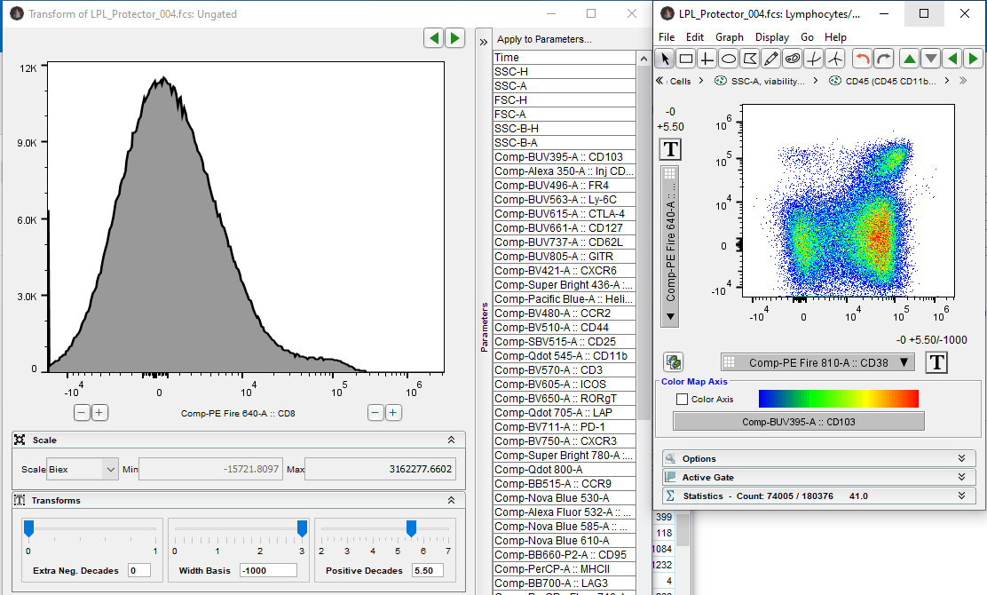
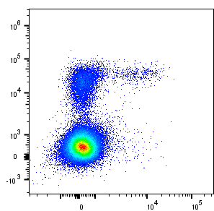
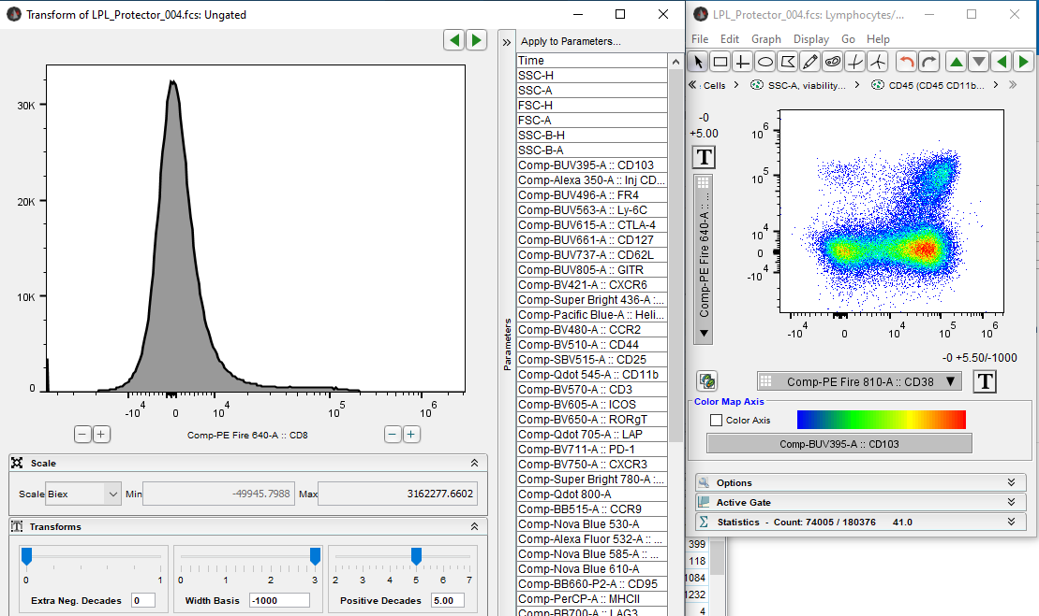
Advanced
For panels with high spread, you may wish to compress the axis even further. Usually this indicates a problem in the panel or unmixing. In the example below from 50-color panel, there is a high degree of spreading of the negative in the CD8 channel (y-axis of the biplot). Since this is bimodal and just used for gating, we can compress the negative using the “Positive Decades” slider. The default is 5.50.
For low expression antigens, you may wish to restrict the axis to only display data up to a certain value. For example, see below with IL-10 staining in Tregs where the IL-10 x-axis is at 3x10^5, whereas the Foxp3 y-axis goes up to 3x10^6,
Result with Positive Decades set to 5.00 (less = more compression):

